Slide 1
A Year in reception

Slide 2
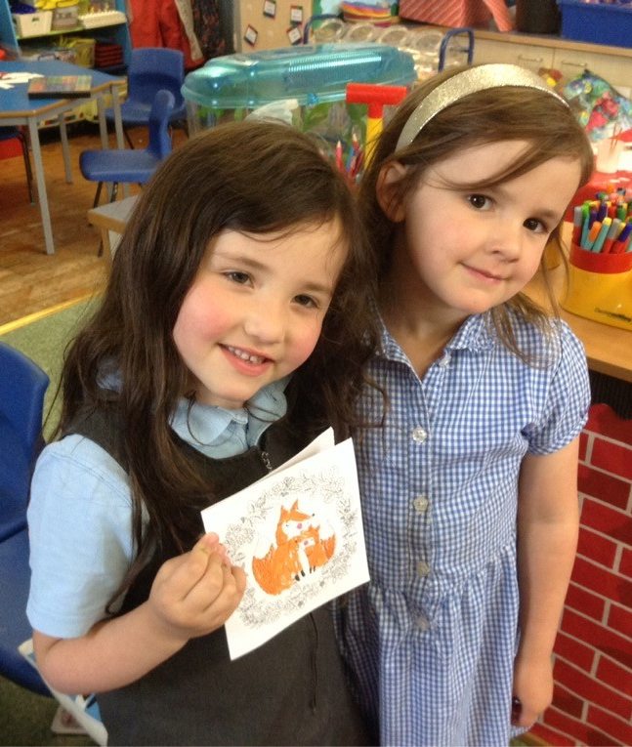
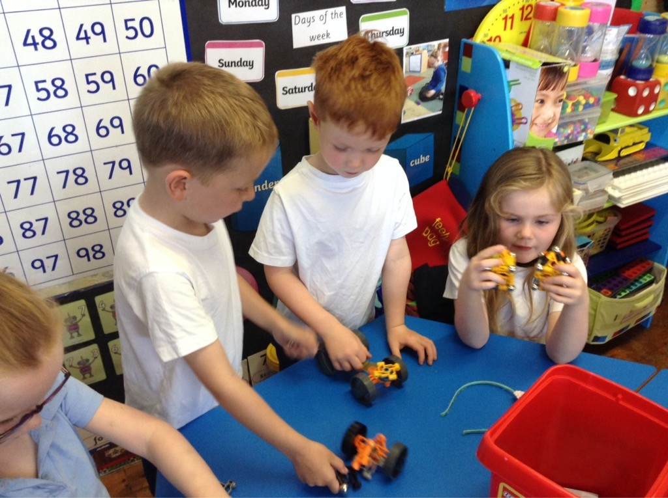
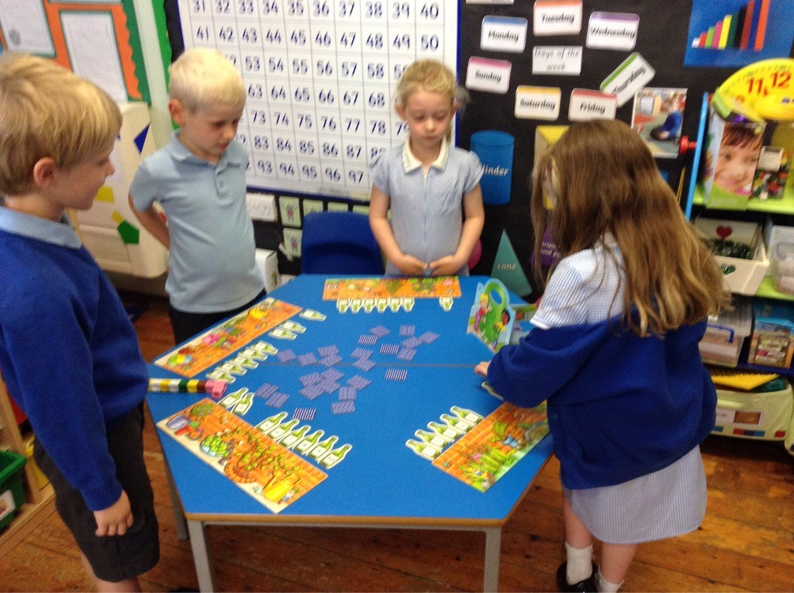
We have learned to share, take turns and be kind to our friends.

Slide 3
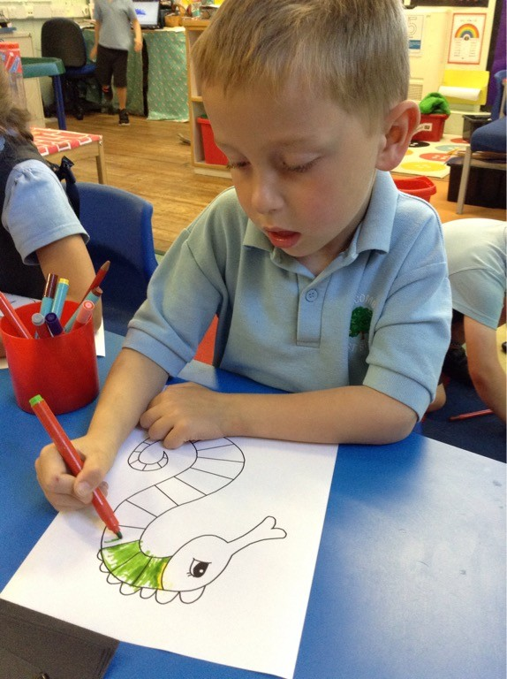
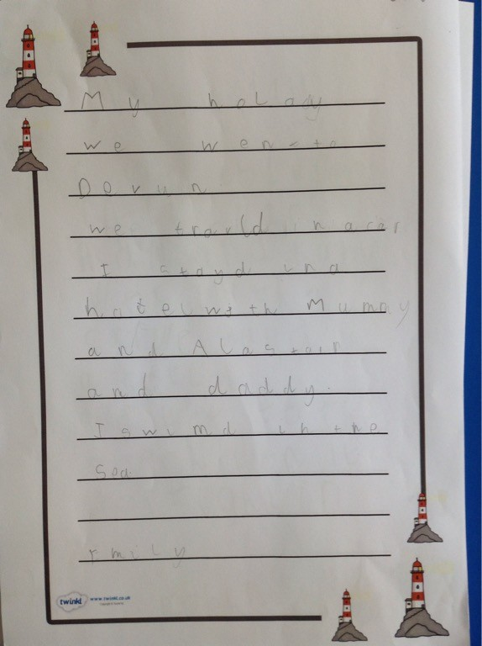
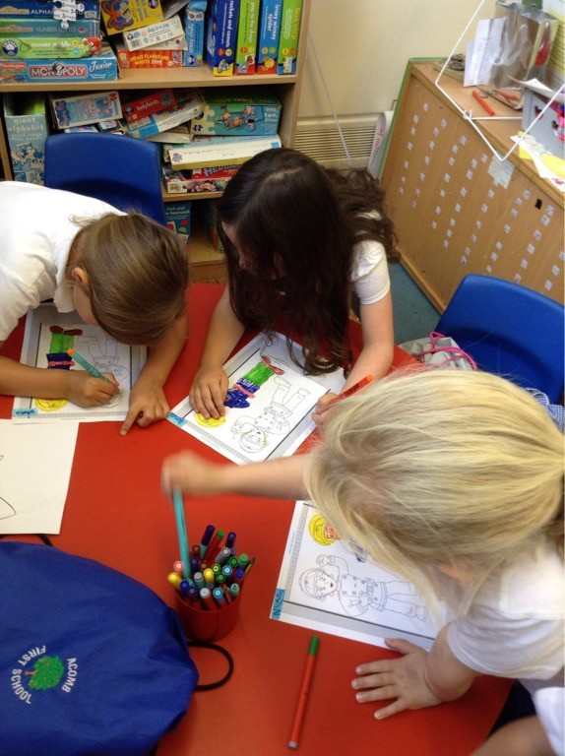
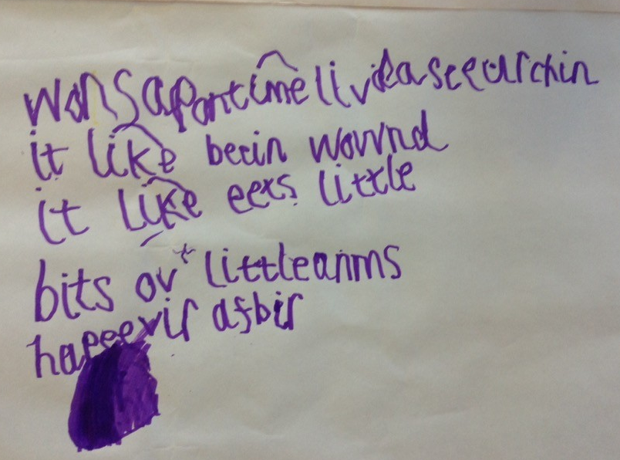
We have learned to control our pencil to colour in and write beautifully.

Slide 4
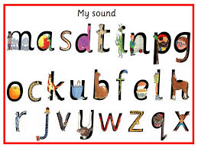
We have learned lots of sounds in RWInc.

Slide 5
We have learned to read and write tricky words.
I to the no go she he

Slide 6
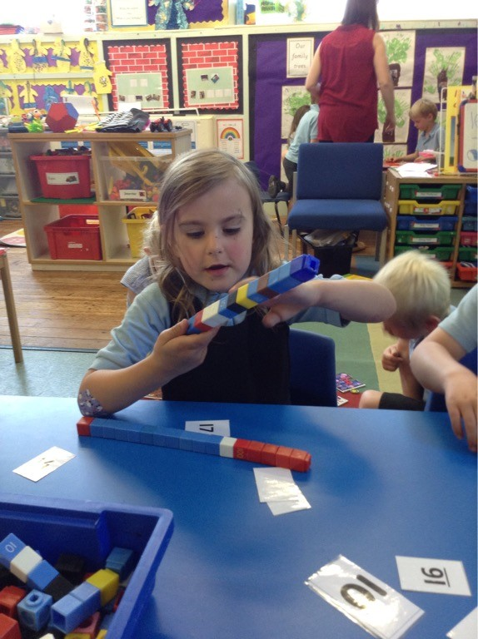
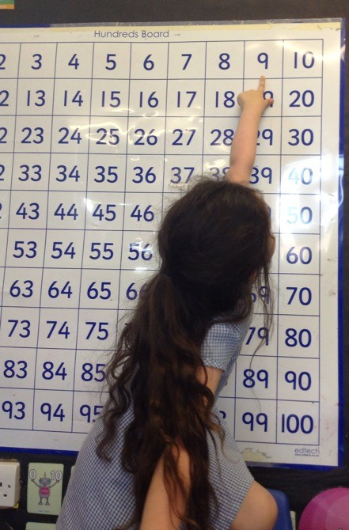
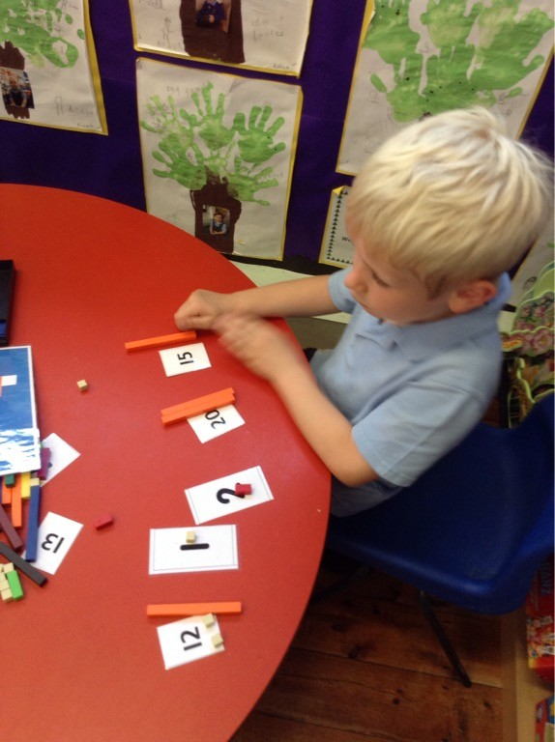
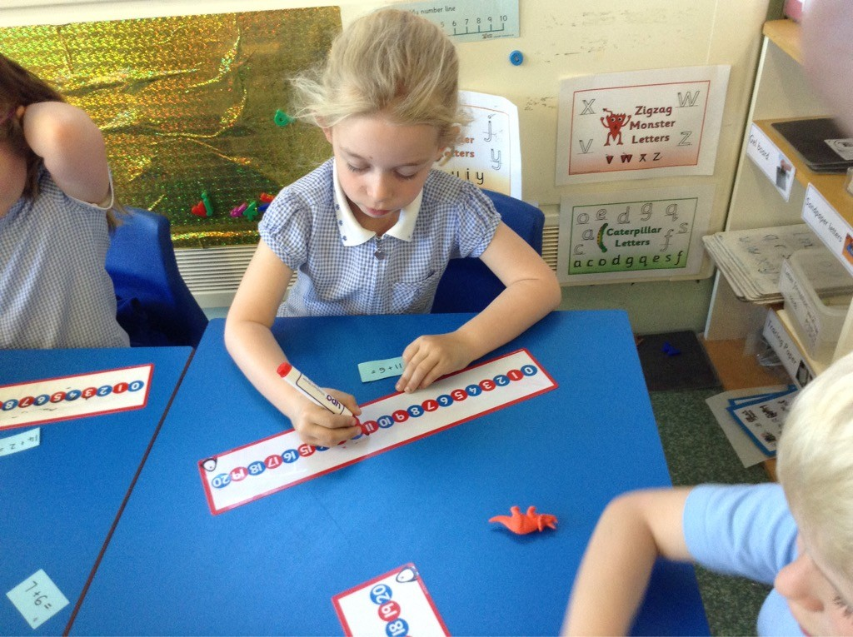
We have learned to count, recognise and order numbers.

Slide 7
We have talked about maths and learned to reason.
“You can’t half the odd ones with sticky out bits cos that wouldn’t be fair.”
Owen
“I’ve got one hundred here.”
How do you know?
“Because 10,20,30,4,50,60,70,80,90,100!”
Joanna

Slide 8
We have learned lots of interesting facts about the world around us.
“Hedgehogs can swim!”
Rufus
“Killer whales are actually dolphins!” Rose

Slide 9
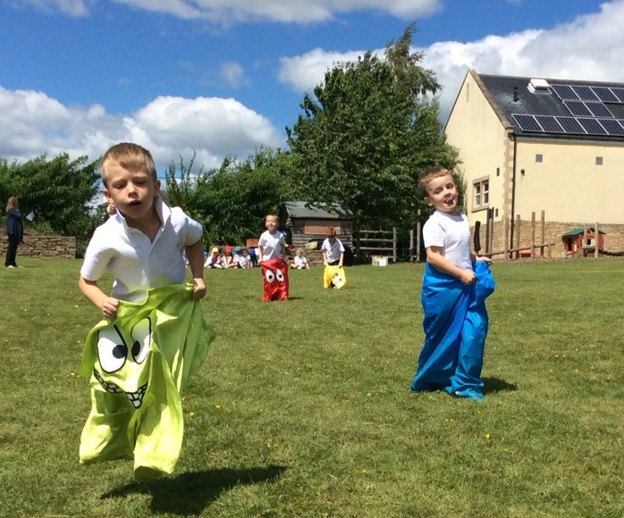
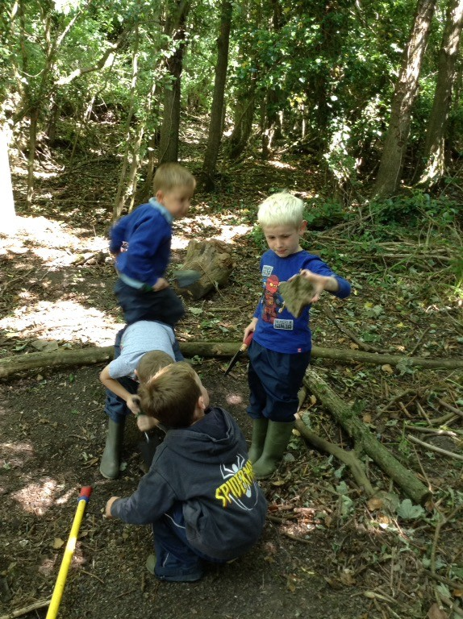
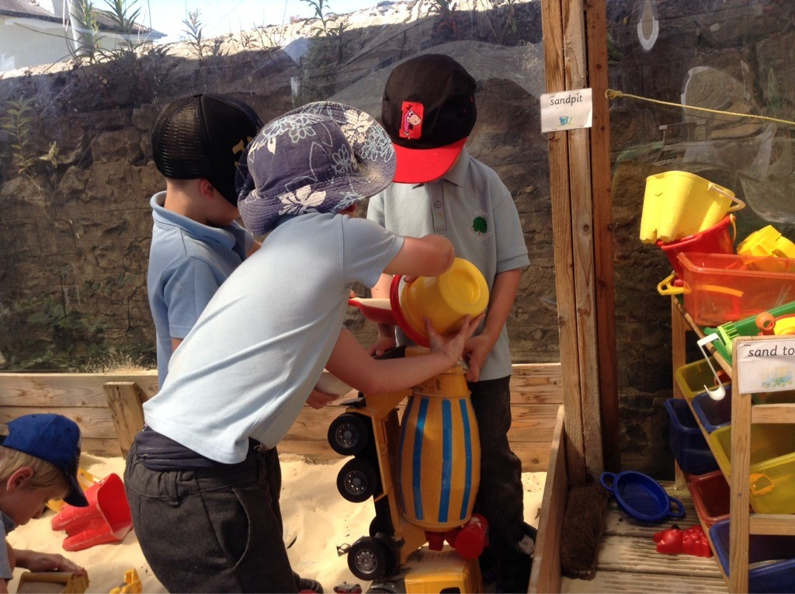
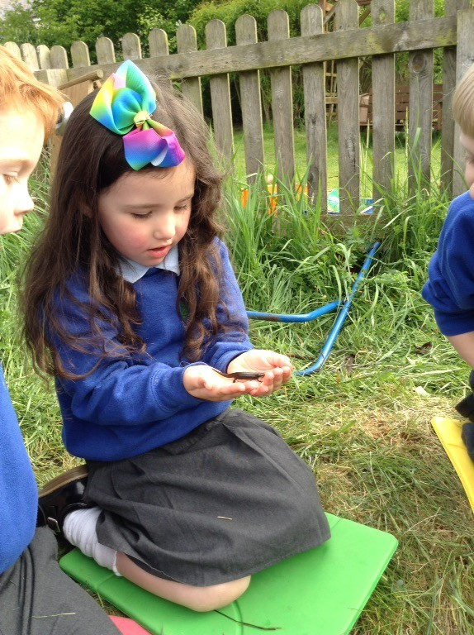
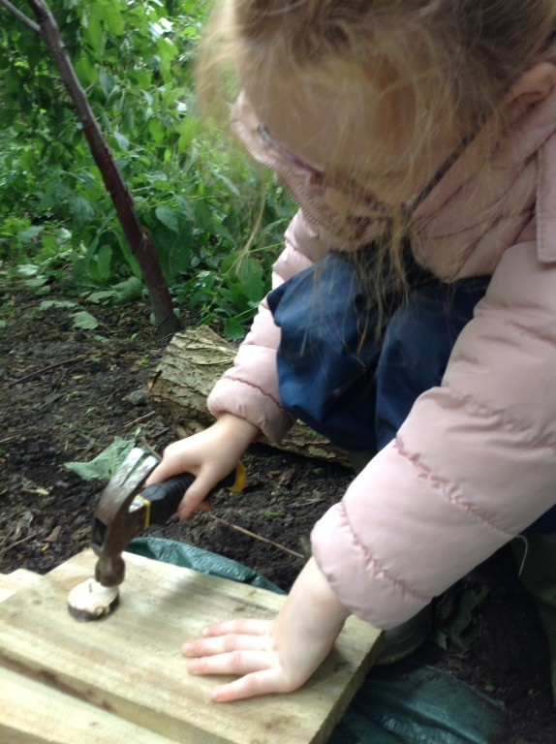
We have had fantastic fun learning outdoors and at Forest school.

Slide 10
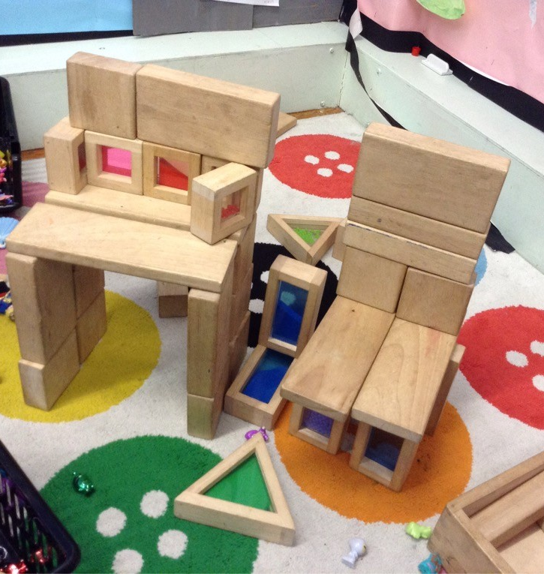
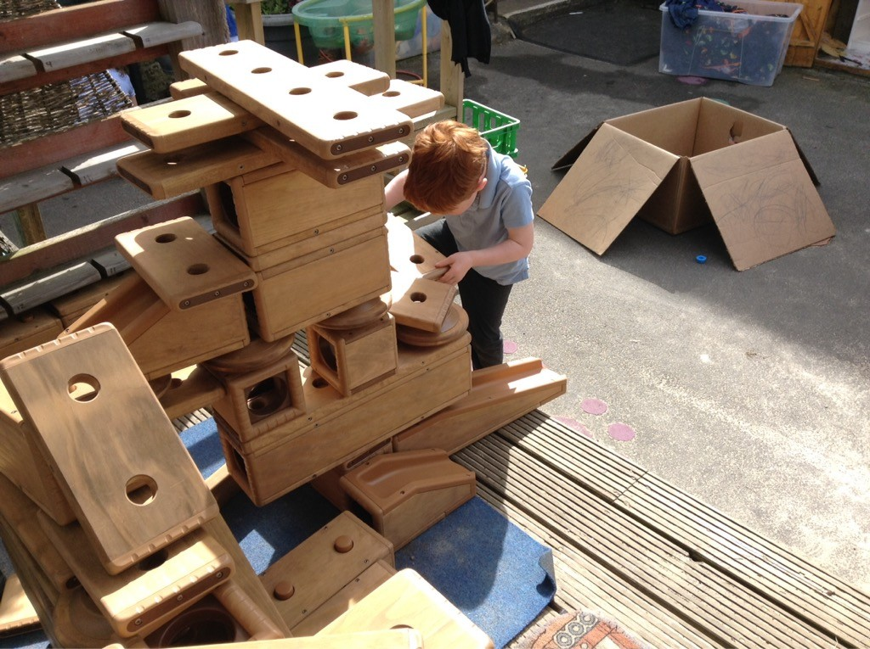
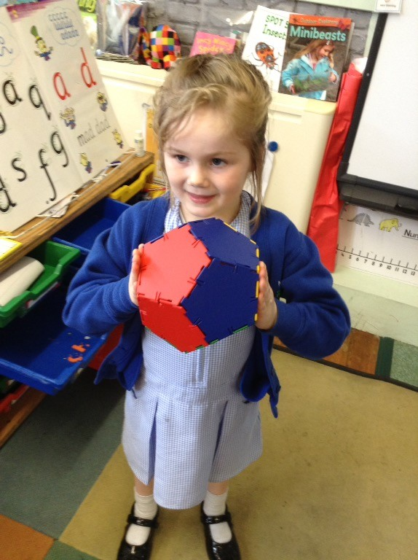
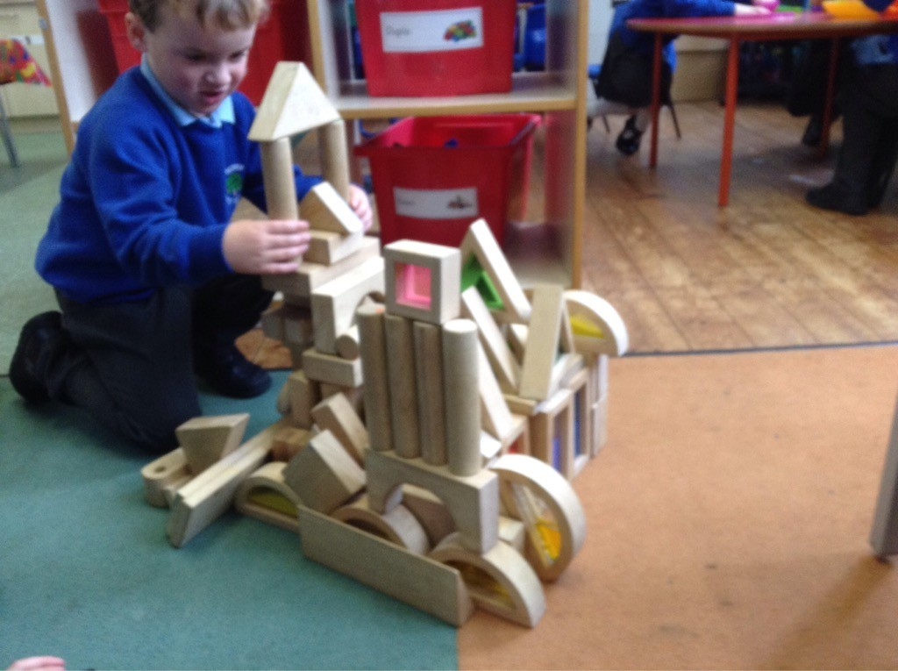
We have become expert builders!

Slide 11
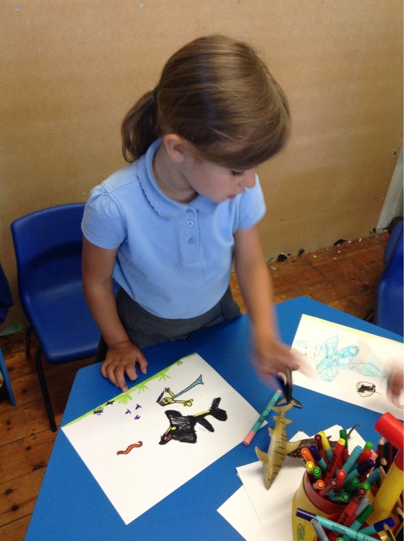
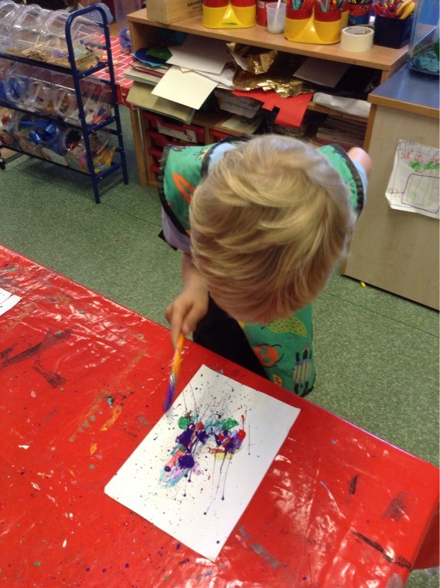
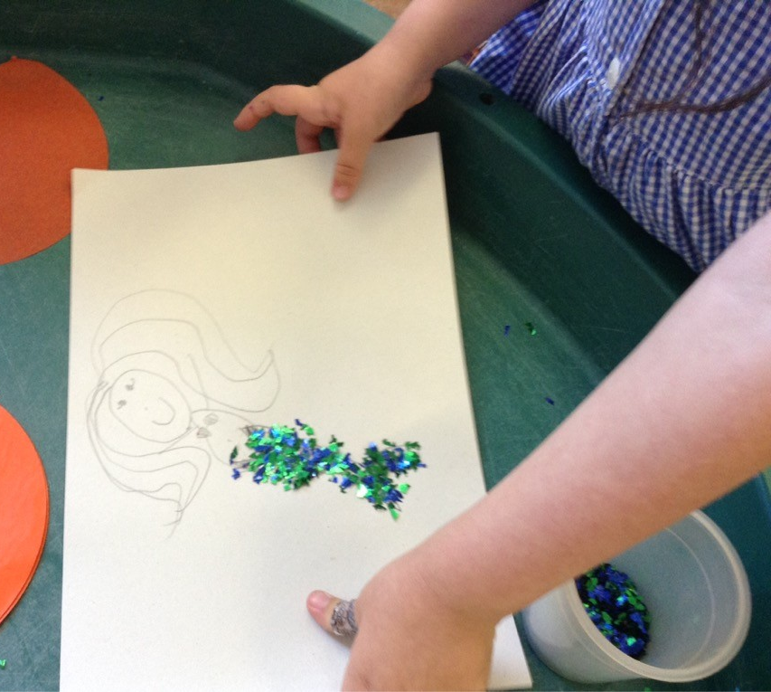
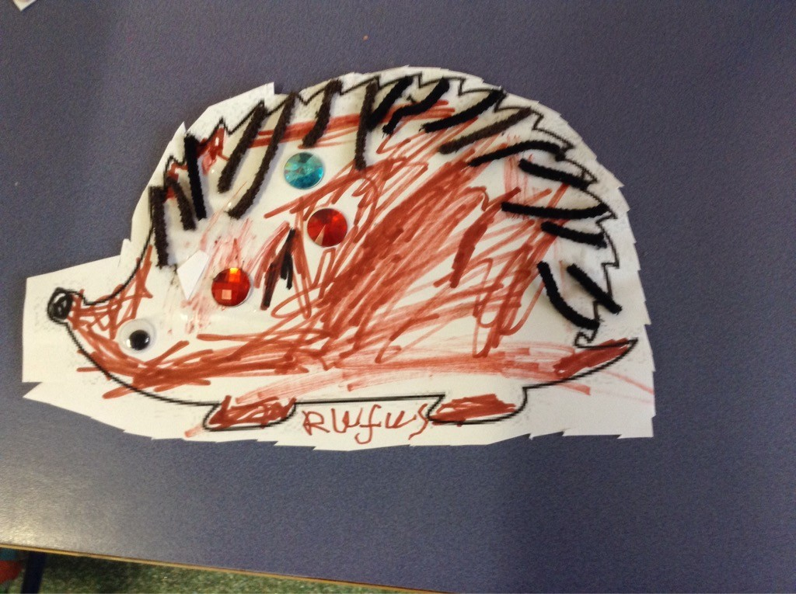
We have tried lots of art activities – collage, painting and drawing.

Slide 12
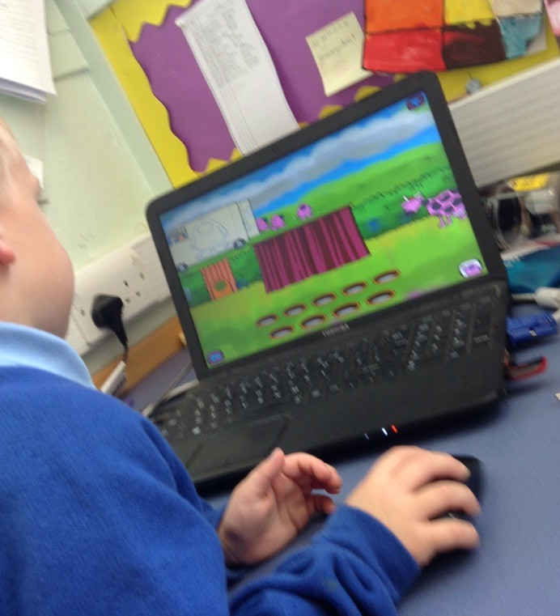
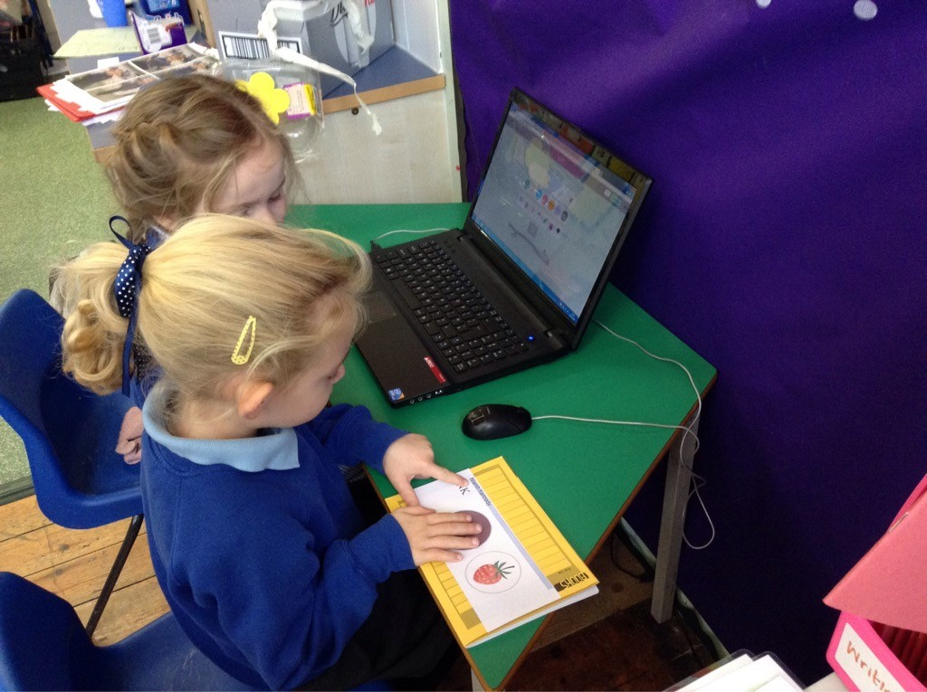
We have used the ipad and laptop to support our learning.

Slide 13
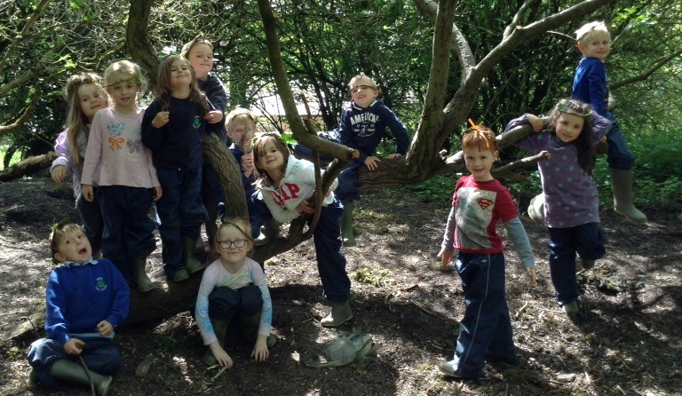
We have enjoyed sharing our learning with our parents on Tapestry.

